Slide 1
Adder Tree / MAC
B11901027 王仁軒
PPT TemplateCredit : Jie-Hong Roland Jiang

Slide 2
Energy Efficiency
TOPS/W drops from 0.65 to 0.33 with the increase of input toggle rate
Tcycle = 2.6ns, 2.30 TOPS/mm2

Slide 3
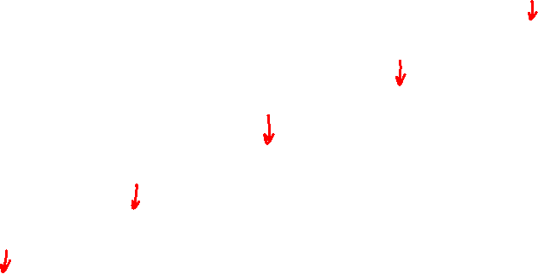
Power of All Adder Tree Stages
Power of first few stages greatly depend on input toggle rate, while other stages do not have obvious dependencies

Slide 4
Input Initial condition
The power distribution in all stages are same as 50% 0’s input pattern’s result

Slide 5
Input Initial condition
The proportion of 0’s in first input pattern does not affect the power of MAC

Slide 6
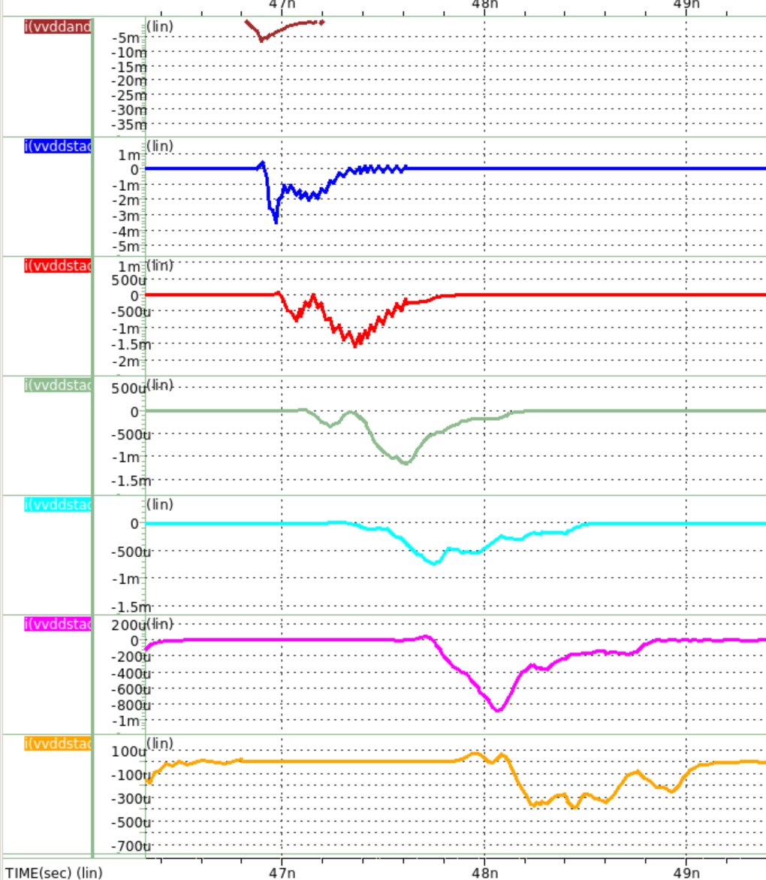
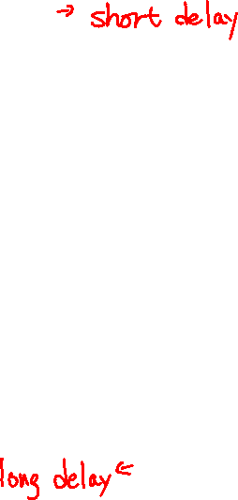
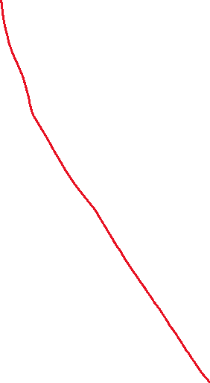
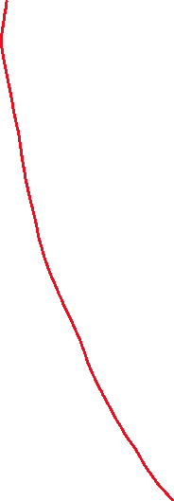
Timing diagram?
AND 7 mA
VDD1 3.5 mA
VDD2 1.6 mA
VDD3 1.2 mA
VDD4 0.7 mA
VDD5 0.9 mA
VDD6 0.3 mA

Slide 7
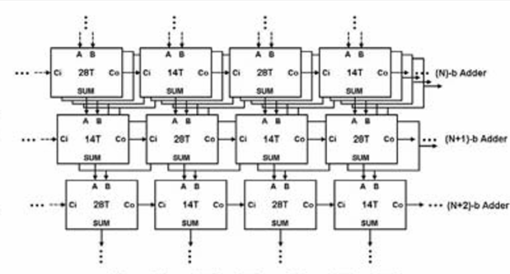
Interleaved FA
Interleave 28T FAs along with 14T Fas
30% smaller than the original design
But require longer cycle time (2.9ns)
Consumes 18% more power in average

Slide 8
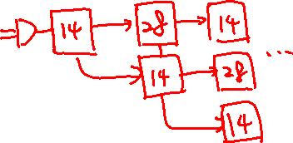
Interleaved FA
Energy Efficiency and Area Efficiency
0.26 TOPS/W, 2.97 TOPS/mm2
Interleaved FA structure consumes more power in most stages

Slide 9
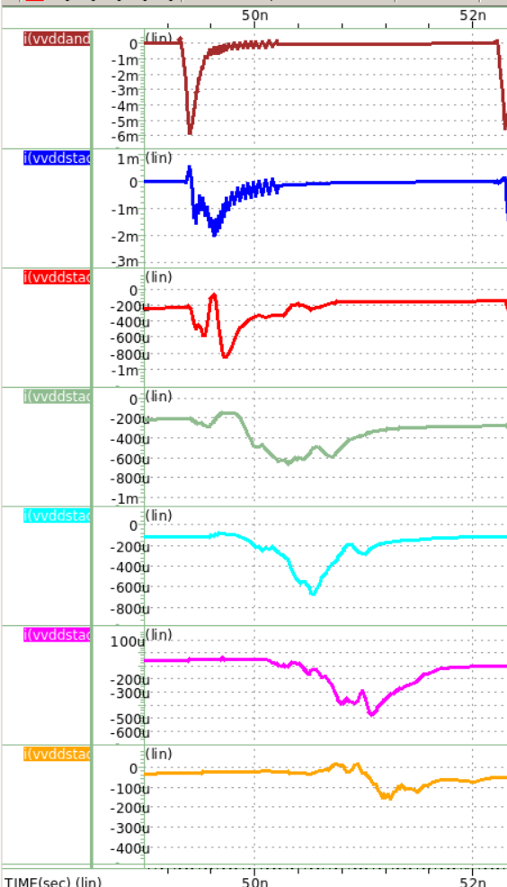
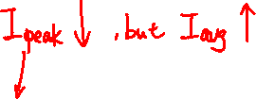
Interleaved FA
AND 6(7) mA
VDD1 2(3.5) mA
VDD2 0.8(1.6) mA
VDD3 0.6(1.2) mA
VDD4 0.7(0.7) mA
VDD5 0.5(0.9) mA
VDD6 0.15(0.3) mA

Slide 10
FA Sizing
High Vth for first few stages
But I don’t know how to modify Vth
Design first few stages smaller and last 2 stages larger
Alternative approach
May require more area

Slide 11
FA Sizing
Applied on the interleaved design
Energy efficiency: 0.26 -> 0.29 TOPS/W
Area efficiency: 2.97 -> 2.81 TOPS/mm2
Slight improvement on energy efficiency
Area efficiency dropped, but not much

Slide 12
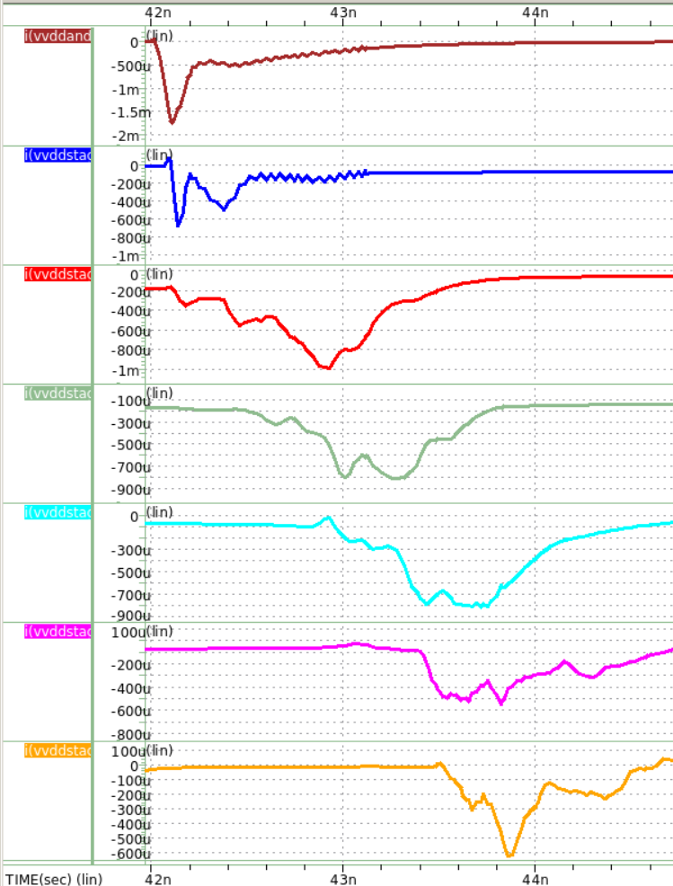
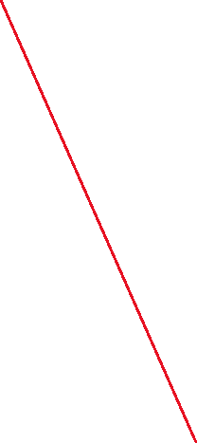
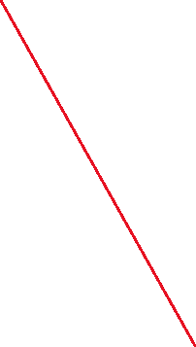
FA Sizing
AND 1.8(6) mA
VDD1 0.7(2) mA
VDD2 1(0.8) mA
VDD3 0.8(0.6) mA
VDD4 0.8(0.7) mA
VDD5 0.6(0.5) mA
VDD6 0.6(0.15) mA

Slide 13

FA Sizing
Apply on the original design
Energy efficiency
0.33 -> 0.36 TOPS/W
Area efficiency
2.30 -> 1.27 TOPS/mm2
Since minimum width is 250nm, increase L to lower drain current -> more area -> bad result

Slide 14
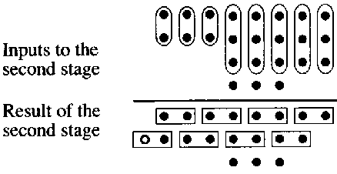

Adder Tree
Calculate 64 1-bit input with groups of 2 input adders
FA has 3 degree of freedom at input but we only utilize 2 of them
We should use the FA fully
Carry save adder design
Multiple input

Slide 15
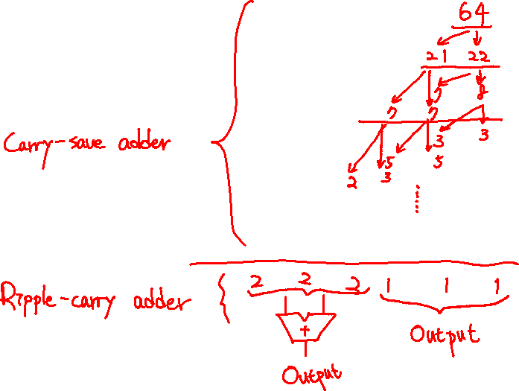
Adder Tree

Slide 16
Carry Save Adder Tree
For regular 64b to 6b adder tree
Require 120 Full adders
Ripple carry adders propagate carries in every stage
Long critical path
Carry save adder design
Only 67 full adders is used
Only need to propagate carry in the last stage
Relatively short critical path

Slide 17
CSA Tree Performance
0.45 TOPS/W
36% improvement w.r.t. the original design
4.33 TOPS/mm2
88% improvement w.r.t. the original design
2.3 ns cycle time
15% less than the original design

Slide 18
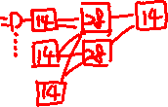
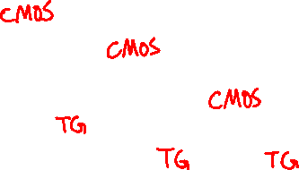
CSA Tree with interleaving
1st stage: 14T, 2nd stage: 28T ……
But ensure output are driven by 28T FA
37/67 FAs are replaced by 14T FA
Performance
0.43 TOPS/W, 4.47 TOPS/mm2

Slide 19

CSA Tree with inverting FA
More than better
Use inverting full adders to remove the redundant inverters in FA’s output stage
28T -> 24T
May require extra inverters in some stages and at output
Driving capability of FA may drop due to no buffer at output
Saves some time consumed by INVs but smaller drain currents require more time to charge nodes
A
B
FA
C
FA

Slide 20
Performance of CSA Tree w/ invFA
0.55 TOPS/W, 5.14 TOPS/mm2
22% improvement in energy efficiency
15% improvement in area efficiency
Cycle time = 2.3 ns
What about the design with interleaving
0.51 TOPS/W, 5.35 TOPS/mm2
19% improvement in energy efficiency
19% improvement in area efficiency
Cycle time = 2.9ns

Slide 21


Summary of All Designs
Adder Type | Additional Feature | Energy Efficiency | Area Efficiency | Cycle Time
Ripple Carry | No | 0.33 | 2.30 | 2.6
Ripple Carry | Interleaving | 0.26 | 2.97 | 2.9
Ripple Carry | Sizing | 0.36 | 1.27 | 2.7
Ripple Carry | Interleaving Sizing | 0.29 | 2.81 | 3.0
Carry Save | No | 0.45 | 4.33 | 2.3
Carry Save | Interleaving | 0.43 | 4.47 | 2.9
Carry Save | Inverting | 0.55 | 5.14 | 2.3
Carry Save | Interleaving Inverting | 0.51 | 5.35 | 2.9

Slide 22
Summary
Ripple carry adder tree
Longer delay, large area, and higher power
Easy to implement and debug
Compatible with input size scaling
Carry save adder tree
Shorter delay, small area, and lower power
Hard to implement and debug
Cannot be made to be compatible with input size scaling easily (I don’t know how to)
Maybe even better?
Use abc+yosys to further optimize adder tree

Slide 23
Summary
Standard (do nothing)
Old friends are always reliable
Interleaving
Energy efficiency + Speed <-> Area efficiency
Vth scaling Transistor Sizing
As pathetic as my electric circuit design grade
Inverting Full Adders
Increasing both energy and area efficiency
Very very good idea

